Slide 1
Inheritance Mapping In Hibernate
Compared to JDBC we have one main advantage in hibernate, which is hibernate inheritance. Suppose if we have base and derived classes, now if we save derived(sub) class object, base class object will also be stored into the database. But the thing is we must specify in what table we need to save which object data.

Slide 2
Inheritance Mapping In Hibernate
For Example:
class Payment /// Parent class
{
// content will goes hear
}
class CreditCard extends Payment //// Child Class
{
// content will goes hear
}
See if you save CreditCard class object, then payment class object will also be saved into the database
Hibernate supports 3 types of Inheritance Mappings:
Table per class hierarchy
Table per sub-class hierarchy
Table per concrete class hierarchy

Slide 3
Hibernate Inheritance: Table Per Class Hierarchy
If we save the derived class object like CreditCard or Cheque then automatically Payment class object will also be saved into the database, and in the database all the data will be stored into a single table only, which is base class table for sure.
But hear we must use one extra discriminator column in the database, just to identify which derived class object we have been saved in the table along with the base class object, if we are not using this column hibernate will throws the exception.
Required files_
Payment.java (Base class)
CreditCard.java (Derived class)
Cheque.java (Derived class)
ClientForSave.java (for our logic)
Payment.hbm.xml
hibernate.cfg.xml

Slide 4
Table Per Class Hierarchy
Payment.java:
public class Payment{
private int paymentId;
private double amount;
--------
---------
CreditCard.java
public class CreditCard extends Payment{
private String CreditCardType;
-----------
-----------

Slide 5
Table Per Class Hierarchy
public class ClientForSave {
public static void main(String[] args)
{
Configuration cfg = new Configuration();
cfg.configure("hibernate.cfg.xml");
SessionFactory factory = cfg.buildSessionFactory();
Session session = factory.openSession();
CreditCard c=new CreditCard();
c.setPaymentId(10);
c.setAmount(2500);
c.setCreditCardType("Visa");

Slide 6
Table Per Class Hierarchy
Cheque c1=new Cheque();
c1.setPaymentId(11);
c1.setAmount(2600);
c1.setChequeType("ICICI");
Transaction tx = session.beginTransaction();
session.save(c);
session.save(c1);
System.out.println("Object saved successfully.....!!");
tx.commit();

Slide 7
Table Per Class Hierarchy
Payment.hbm.xml:
<hibernate-mapping>
<class name="str.Payment" table="PAYMENT">
<id name="paymentId" column="pid" />
<discriminator column="dcolumn" type="string" length="5"/>
<property name="amount" column="amt" />
<subclass name="str.CreditCard" discriminator-value="CC">
<property name="CreditCardType" column="cctype" length="10" />
</subclass>
<subclass name="str.Cheque" discriminator-value="cq">
<property name="ChequeType" column="cqtype" length="10" />
</subclass>
</class>
</hibernate-mapping>

Slide 8
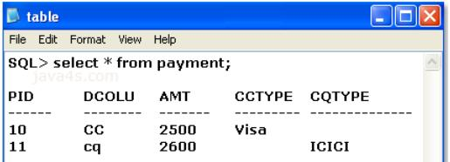
Table Per Class Hierarchy

Slide 9
Table Per subClass Hierarchy
This is also just like previous example, but some changes are there, in table per class hierarchy all the data was saved in a single table but hear,
x number of classes = x number of tables in the database
If we save the CreditCard class object, then first hibernate will saves the data related to super class object into the super class related table in the database and then CreditCard object data in CreditCard related table in the database, so first base class data will be saved
Required files_
Payment.java (Base class)
CreditCard.java (Derived class)
Cheque.java (Derived class)
ClientForSave.java (for our logic)
Payment.hbm.xml
hibernate.cfg.xml

Slide 10
Table Per subClass Hierarchy
Payment.java:
public class Payment{
private int paymentId;
private double amount;
CreditCard.java:
public class CreditCard extends Payment{
private String CreditCardType;

Slide 11
Table Per subClass Hierarchy
ClientForSave.java
public class ClientForSave {
public static void main(String[] args)
{
Configuration cfg = new Configuration();
cfg.configure("hibernate.cfg.xml");
SessionFactory factory = cfg.buildSessionFactory();
Session session = factory.openSession();
CreditCard c=new CreditCard();
c.setPaymentId(10);
c.setAmount(2500);
c.setCreditCardType("Visa");
Cheque c1=new Cheque();
c1.setPaymentId(11);
c1.setAmount(2600);
c1.setChequeType("ICICI");
Transaction tx = session.beginTransaction();
session.save(c);
session.save(c1);
System.out.println("Object saved successfully.....!!");
tx.commit();

Slide 12
Table Per subClass Hierarchy
Payment.hbm.xml:
<hibernate-mapping>
<class name="str.Payment" table="PAYMENT">
<id name="paymentId" column="pid" />
<property name="amount" column="amt" />
<joined-subclass name="str.CreditCard" table="CreditCard">
<key column="dummy1" />
<property name="CreditCardType" column="cctype" length="10" />
</joined-subclass>
<joined-subclass name="str.Cheque" table="Cheque">
<key column="dummy2" />
<property name="ChequeType" column="cqtype" length="10" />
</joined-subclass>
</class>
</hibernate-mapping>

Slide 13
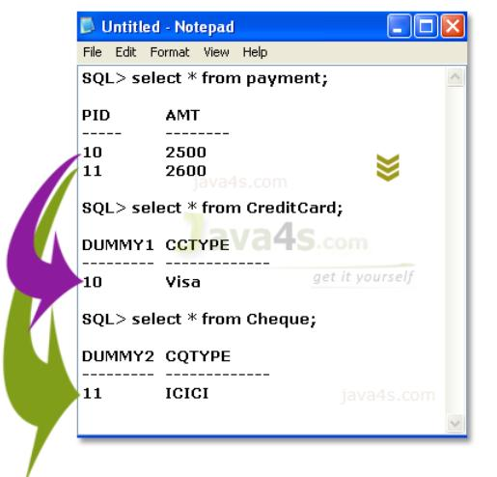
Table Per subClass Hierarchy

Slide 14
Table Per Concrete Class Hierarchy
Something like previous example but the changes are at mapping file only, and one more thing is..
x number of derived classes = x number of tables in the database
Once we save the derived class object, then derived class data and base class data will be saved in the derived class related table in the database
for this type we need the tables for derived classes, but not for the base class
in the mapping file we need to use one new element <union-subclass — >under <class —>
Required files_
Payment.java (Base class)
CreditCard.java (Derived class)
Cheque.java (Derived class)
ClientForSave.java (for our logic)
Payment.hbm.xml
hibernate.cfg.xml

Slide 15
Table Per Concrete Class
Payment.java:
public class Payment{
private int paymentId;
private double amount;
CreditCard.java:
public class CreditCard extends Payment{
private String CreditCardType;

Slide 16
Table Per Concrete Class
ClientForSave.java
public class ClientForSave {
public static void main(String[] args)
{
Configuration cfg = new Configuration();
cfg.configure("hibernate.cfg.xml");
SessionFactory factory = cfg.buildSessionFactory();
Session session = factory.openSession();
CreditCard c=new CreditCard();
c.setPaymentId(10);
c.setAmount(2500);
c.setCreditCardType("Visa");
Cheque c1=new Cheque();
c1.setPaymentId(11);
c1.setAmount(2600);
c1.setChequeType("ICICI");
Transaction tx = session.beginTransaction();
session.save(c);
session.save(c1);
System.out.println("Object saved successfully.....!!");
tx.commit();

Slide 17
Table Per Concrete Class
Payment.hbm.xml:
<hibernate-mapping>
<class name="str.Payment" table="PAYMENT">
<id name="paymentId" column="pid" />
<property name="amount" column="amt" />
<union-subclass name="str.CreditCard">
<property name="CreditCardType" column="cctype" length="10" />
</union-subclass>
<union-subclass name="str.Cheque">
<property name="ChequeType" column="cqtype" length="10" />
</union-subclass>
</class>
</hibernate-mapping>

Slide 18
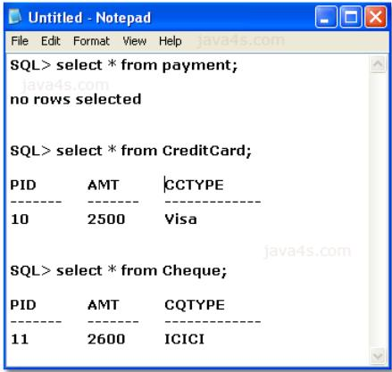
Table Per Concrete Class

